Slide 1
DATA Edge
Team 5

Slide 2
Agenda
01
02
03
Data Model
Revenue Analysis
Cost -Revenue
Analysis
04
05
06
Staff Analysis and
Billable Hours
Conclusion
Dashboards
and
Q&A

Slide 3
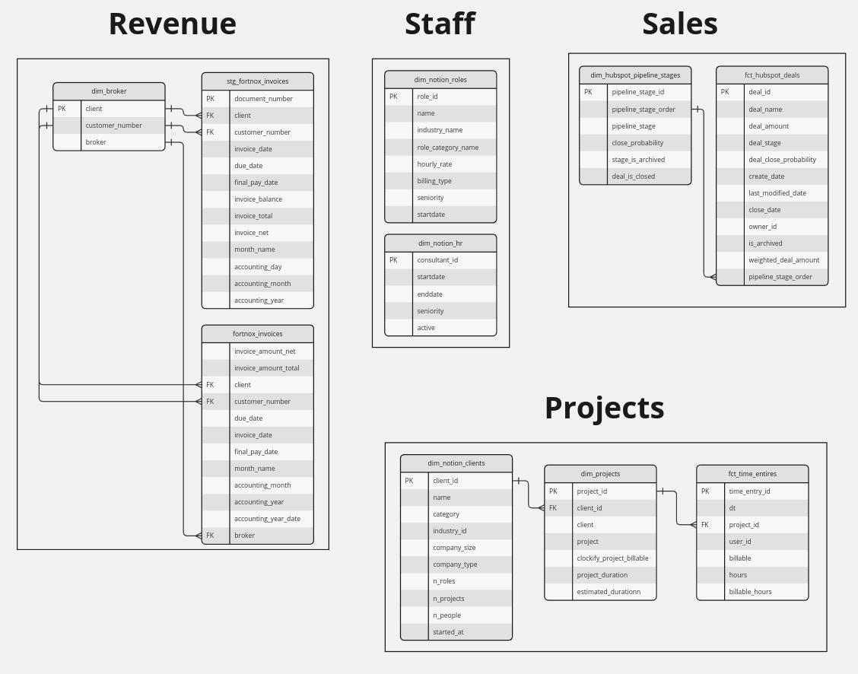
Data Model for Data Edge
Notes:
We received data in the form of CSV files. We tried to figure out the relations

Slide 4
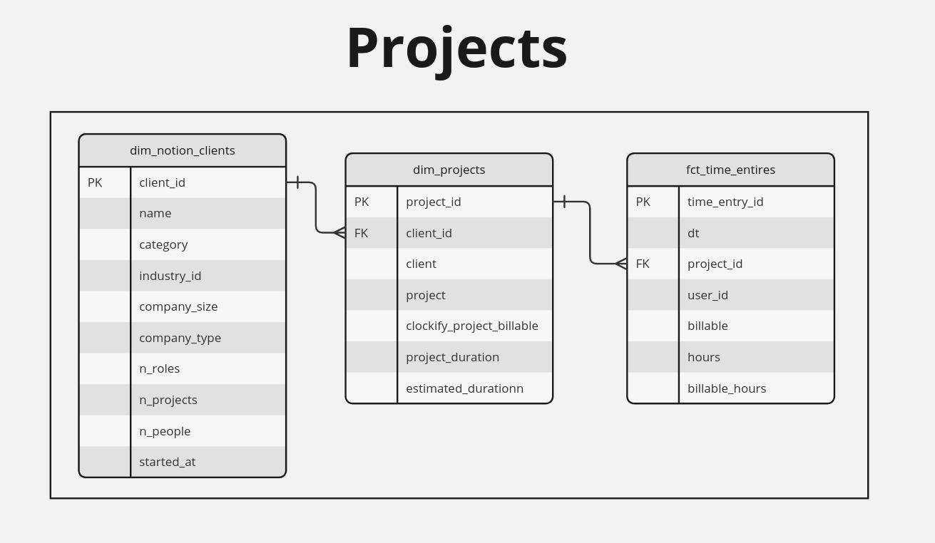
Notes:
We received data in the form of CSV files. We tried to figure out the relations

Slide 5
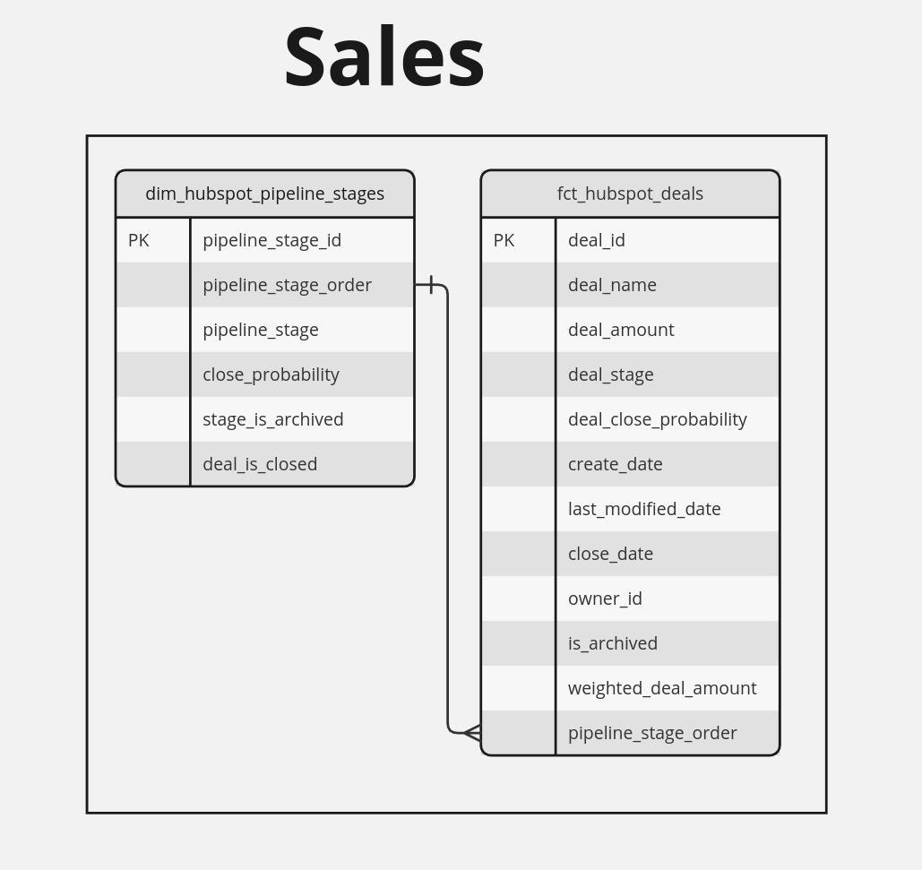
Notes:
We received data in the form of CSV files. We tried to figure out the relations

Slide 6
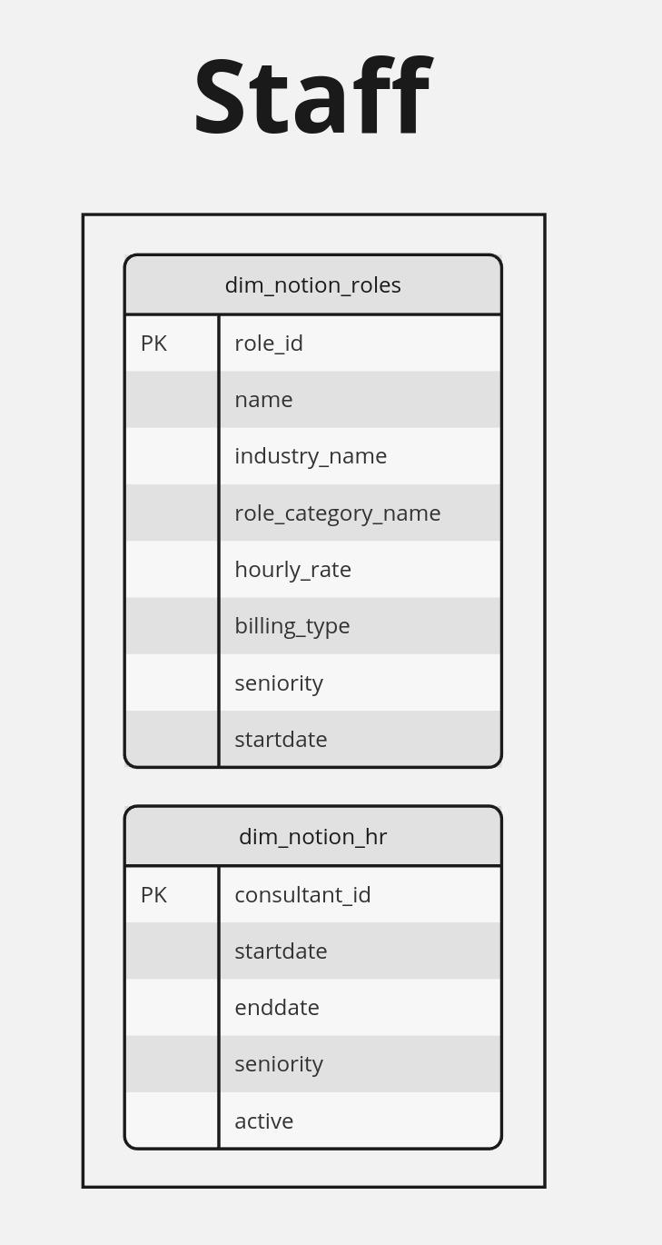
Notes:
We received data in the form of CSV files. We tried to figure out the relations

Slide 7
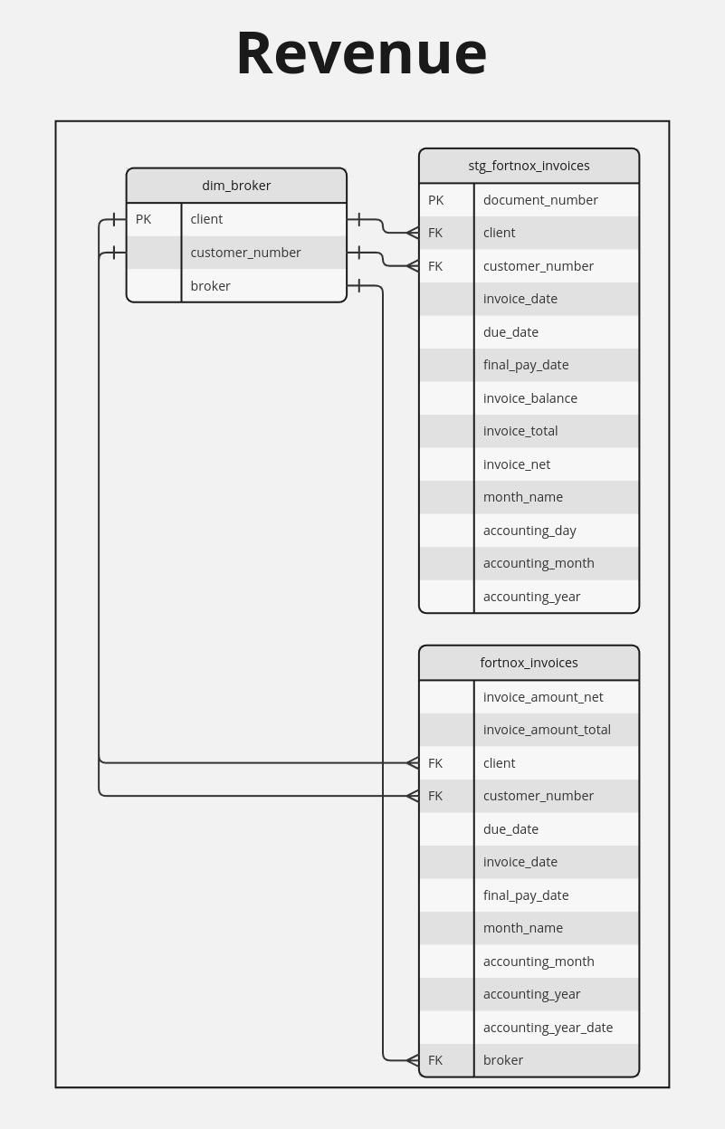
Notes:
We received data in the form of CSV files. We tried to figure out the relations

Slide 8
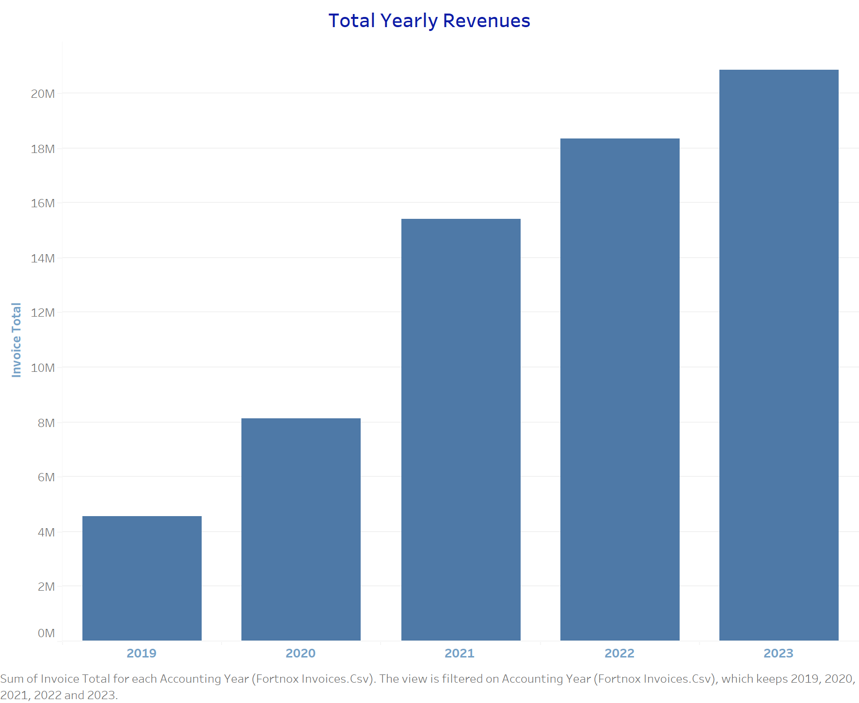
Revenue Growth
Total Revenue
Steady growth between 2019-2023
90%
Annual Growth Rate
2020: 78%
2021: 90%
2022: 19%
2023: 24%
Notes:
The very important metric that we looked at was revenue and as we can see the revenue metric has been steadily growing since 2019 and we also looked at the annual growth rate from 2020-2021 and from 2020-21 its been a growth with 90 percent and from, 2021-22 19 percent and 2022-2023 24 percent.

Slide 9
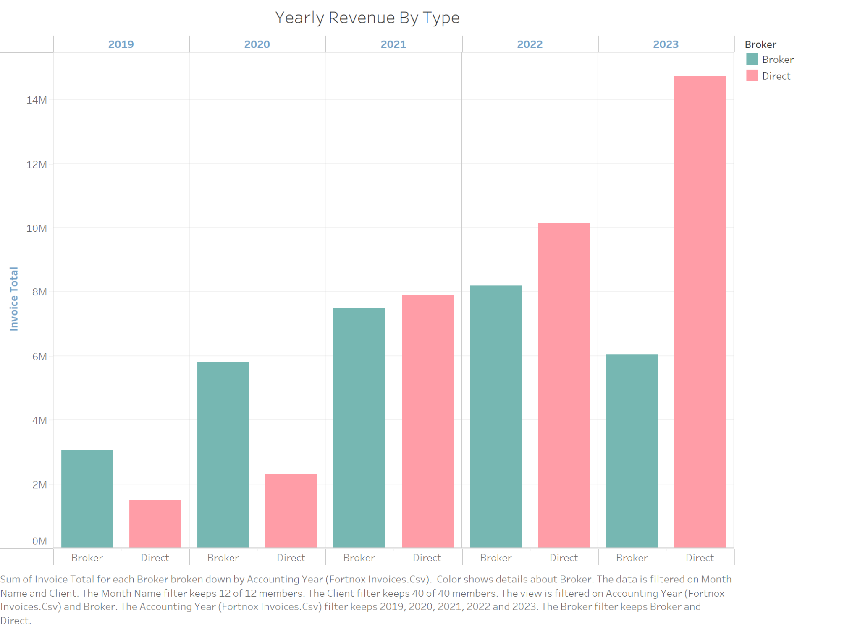
Revenue Breakdown
Major revenue driver: Direct consultancy
Notes:
When we break down the increase in revenue we can see it has been mostly driven by direct consultancy, as opposed to broker deals. We can further breakdown to what client that contributes to Data Edges “success” in a dashboard that we will show at the end of the presentation.

Slide 10
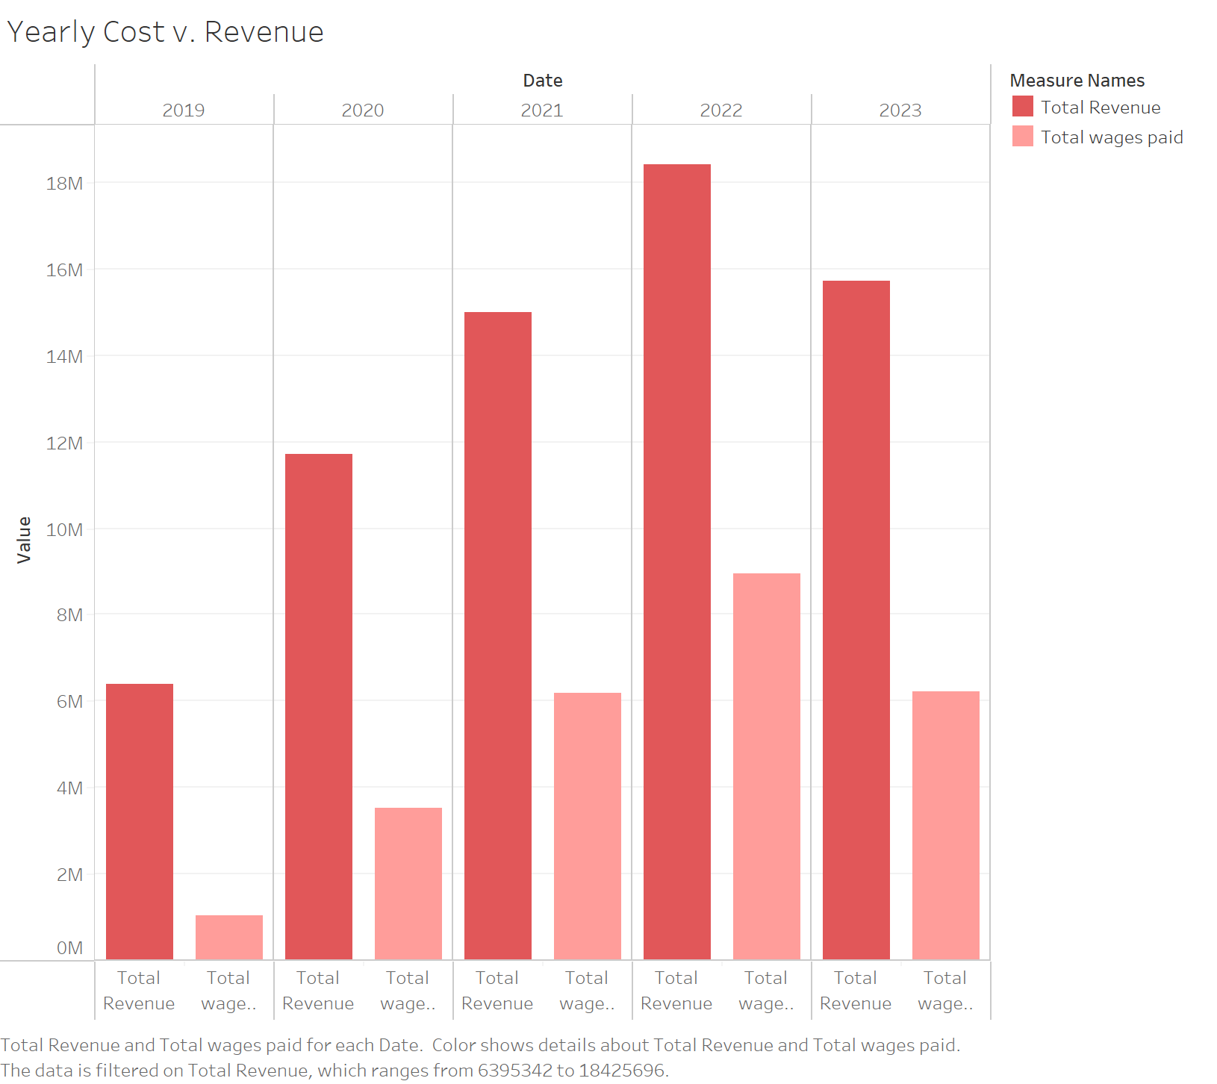
Cost-Revenue
2023 cost drop due to fiscal year shift (starting May 1)
Slow, steady growth in both revenue and costs
Dashboard available for comparing cost and revenue metrics
Notes:
An important piece of the puzzle is costs if we actually want to evaluate the business performance. As you see there’s a drop in 2023 which is different from the previous graph shown, and that’s because is not the calendar year anymore. It is the accounting year which starts on May 1st. It’s a slow and steady growth in Data Edges revenue and also in the costs. We also have a dashboard where you can compare metrics for cost and revenue before and after tax and for different years if you want to further explore cost and revenue.

Slide 11
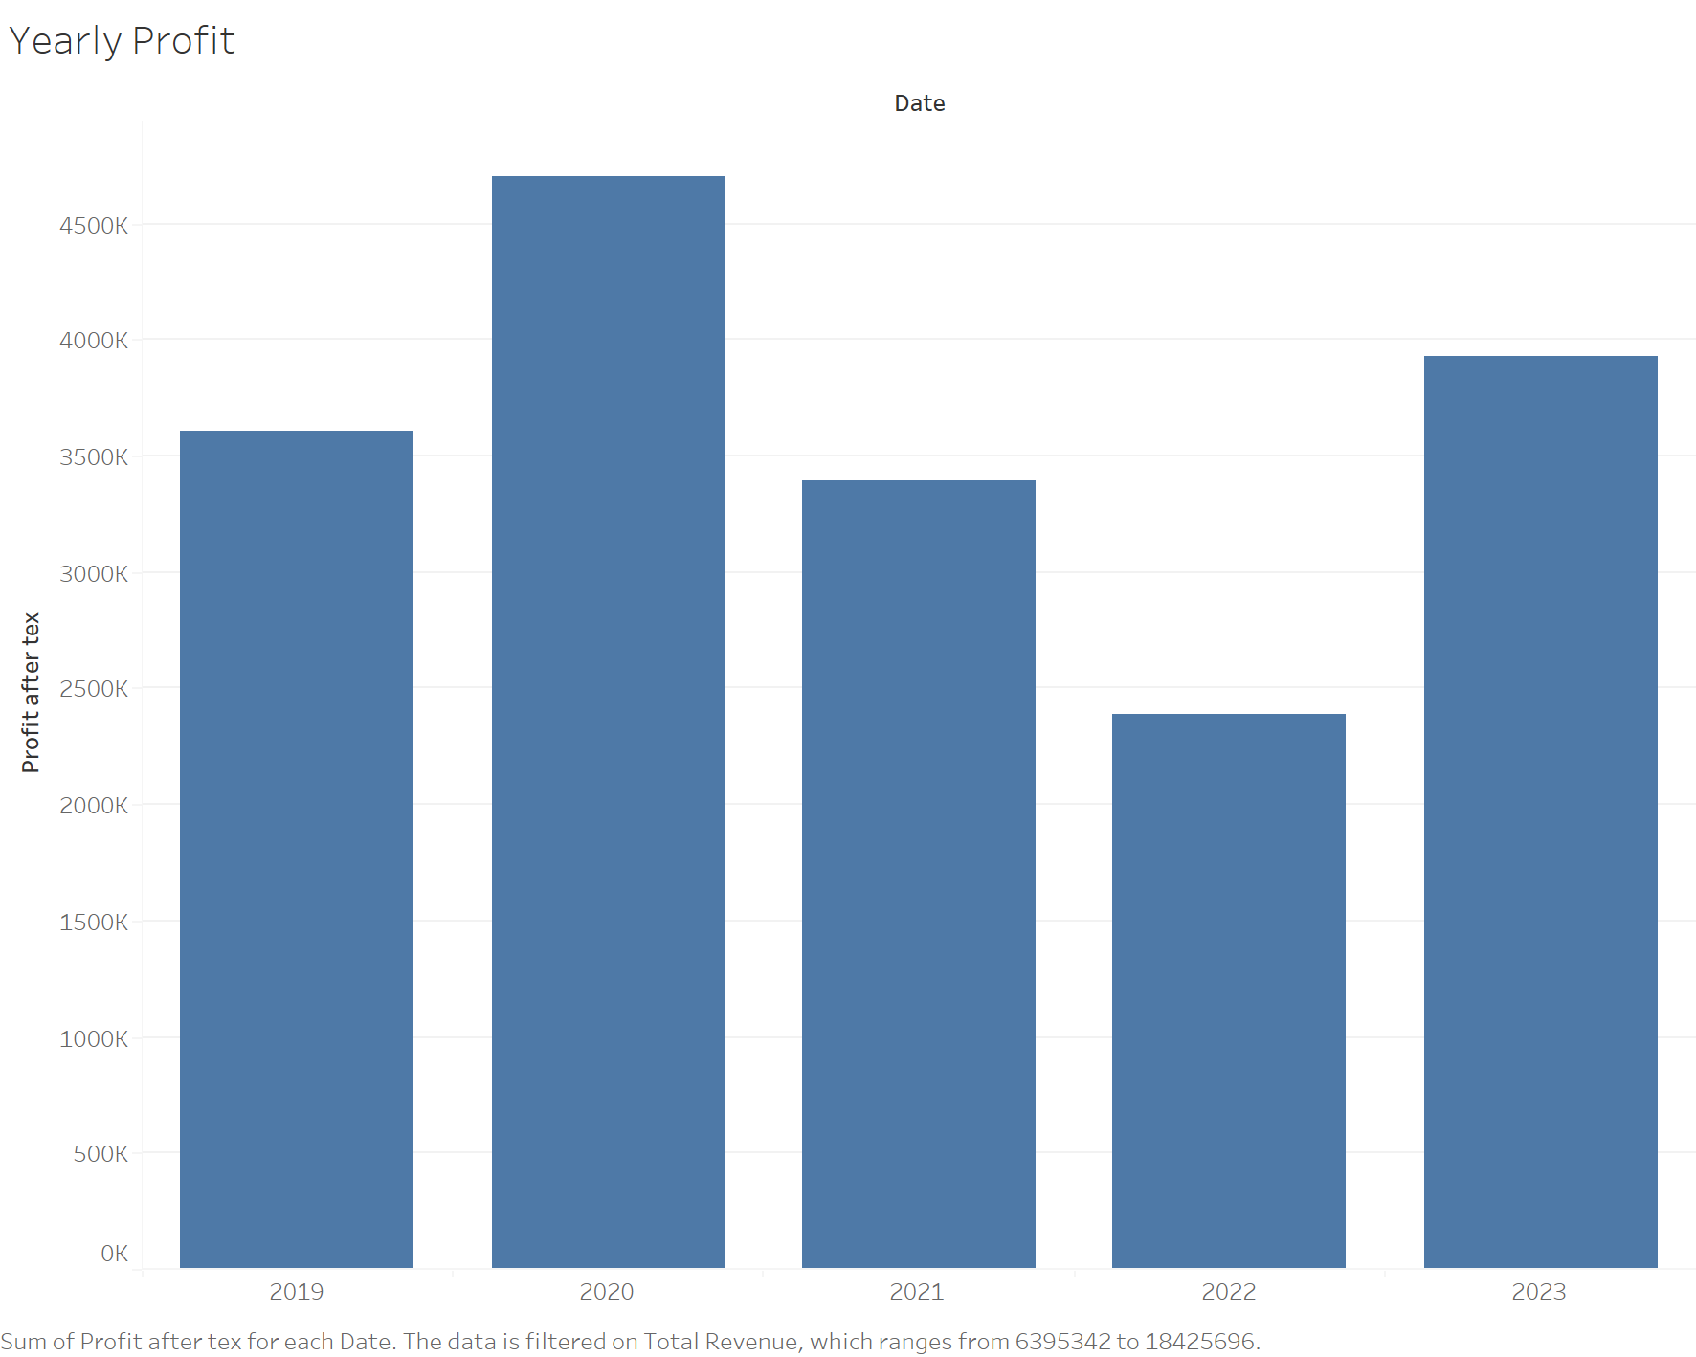
Yearly Profit
Yearly profit after tax shown
Decrease in profit from 2020-2022
Raises questions about sustainable growth
Notes:
The difference in the rate of change between costs and revenue translates into the yearly profit, as shown here. This is profit after tax as you can see, the profit after tax have been decreasing from year 2020-2022. This and raises questions in terms of steady and sustainable growth.

Slide 12
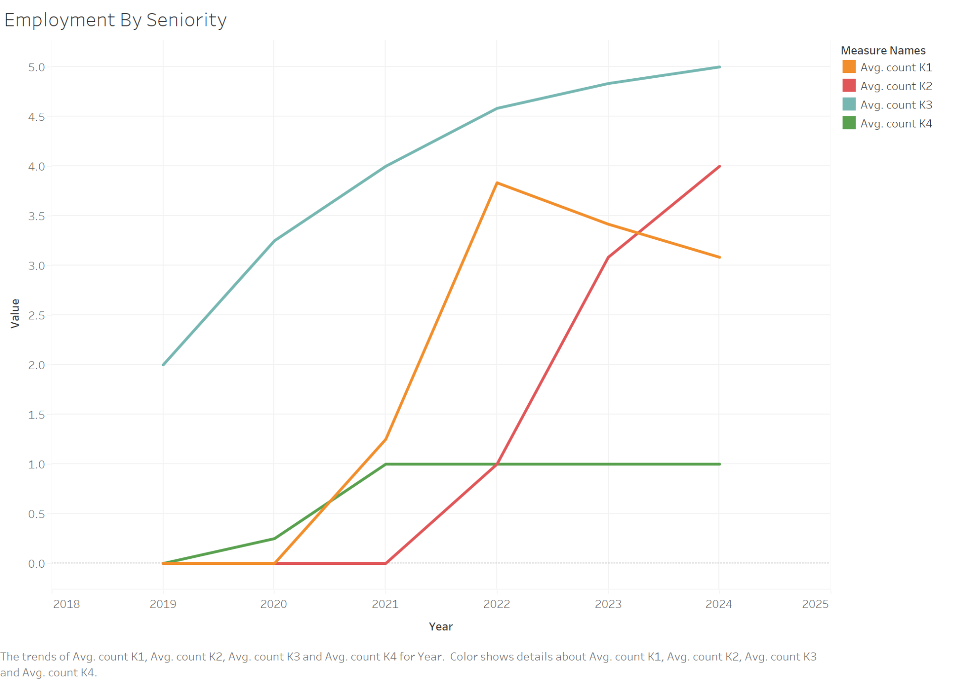
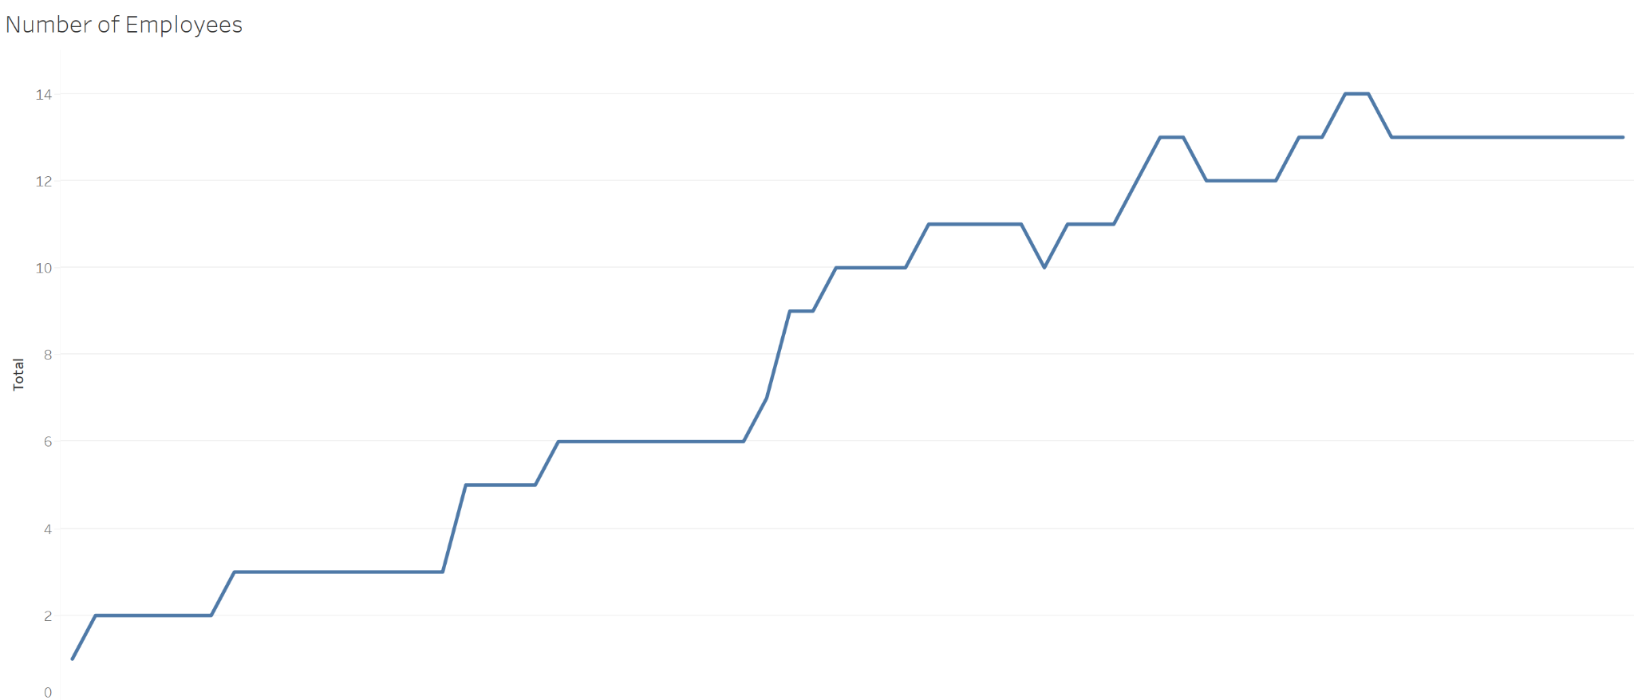
Staff Employment Costs
Total Wage Costs
14
12
Annual and monthly wage expenses
10
8
6
Average Salary per Employee
4
2
2019
2020
2021
2022
2023
2024
Notes:
As the main driver of costs at Data Edge is staff employment, it's crucial to pay attention to salaries, which are closely linked to seniority levels. This slide provides a graphic representation of number of employees over time and a breakdown of the average number of employees per year, categorized by their seniority levels. The major contributor to the general trend of increasing costs has been the rise in salaries and affiliated employment costs. W the decrease in the number of employees from 2022 to 2023 has helped reduce costs and resulted in higher profit.

Slide 13
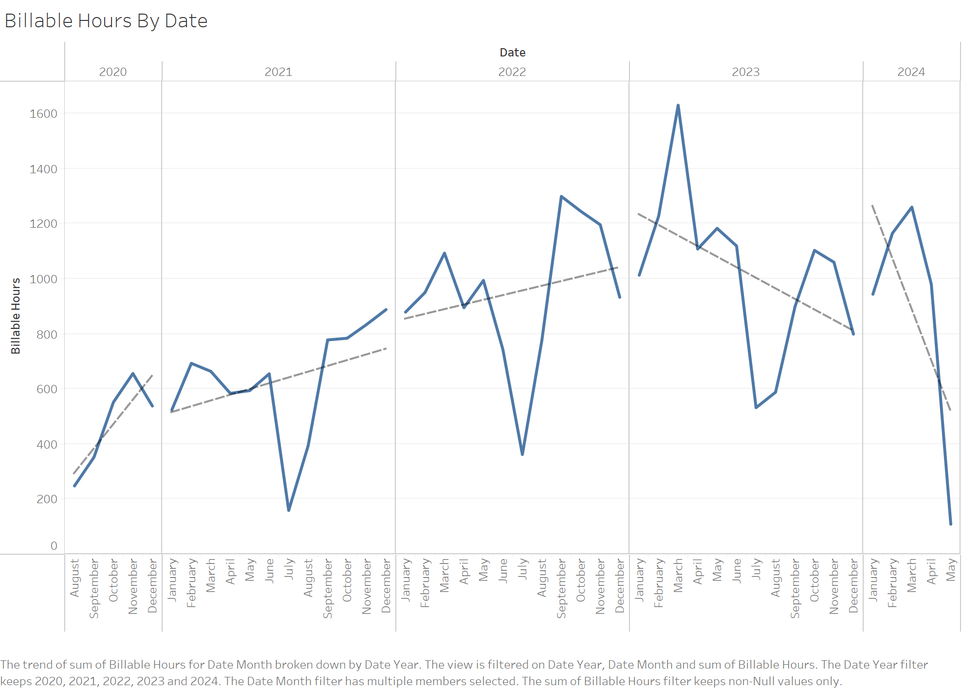
Billable Hours
Billable hours as part of general growth
Seasonal drops in summer (Sweden)
Apparent 2024 drop due to incomplete year
Notes:
This slide shows a breakdown of billable hours by date. We can observe that the increase in billable hours has been closely correlated with the increase in number of employees and also with revenue growth. The drops in summer are expected in Sweden. Note that the apparent drop in 2024 is because the year is not complete yet.

Slide 14
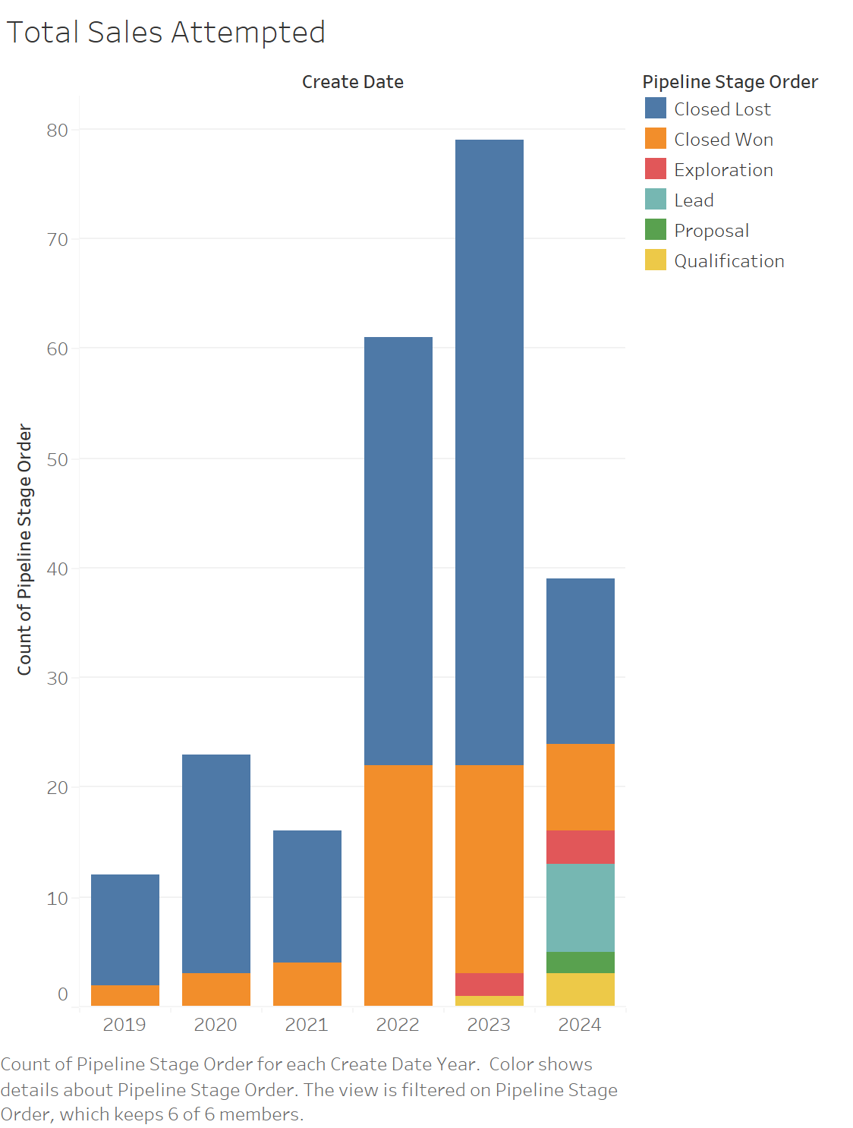
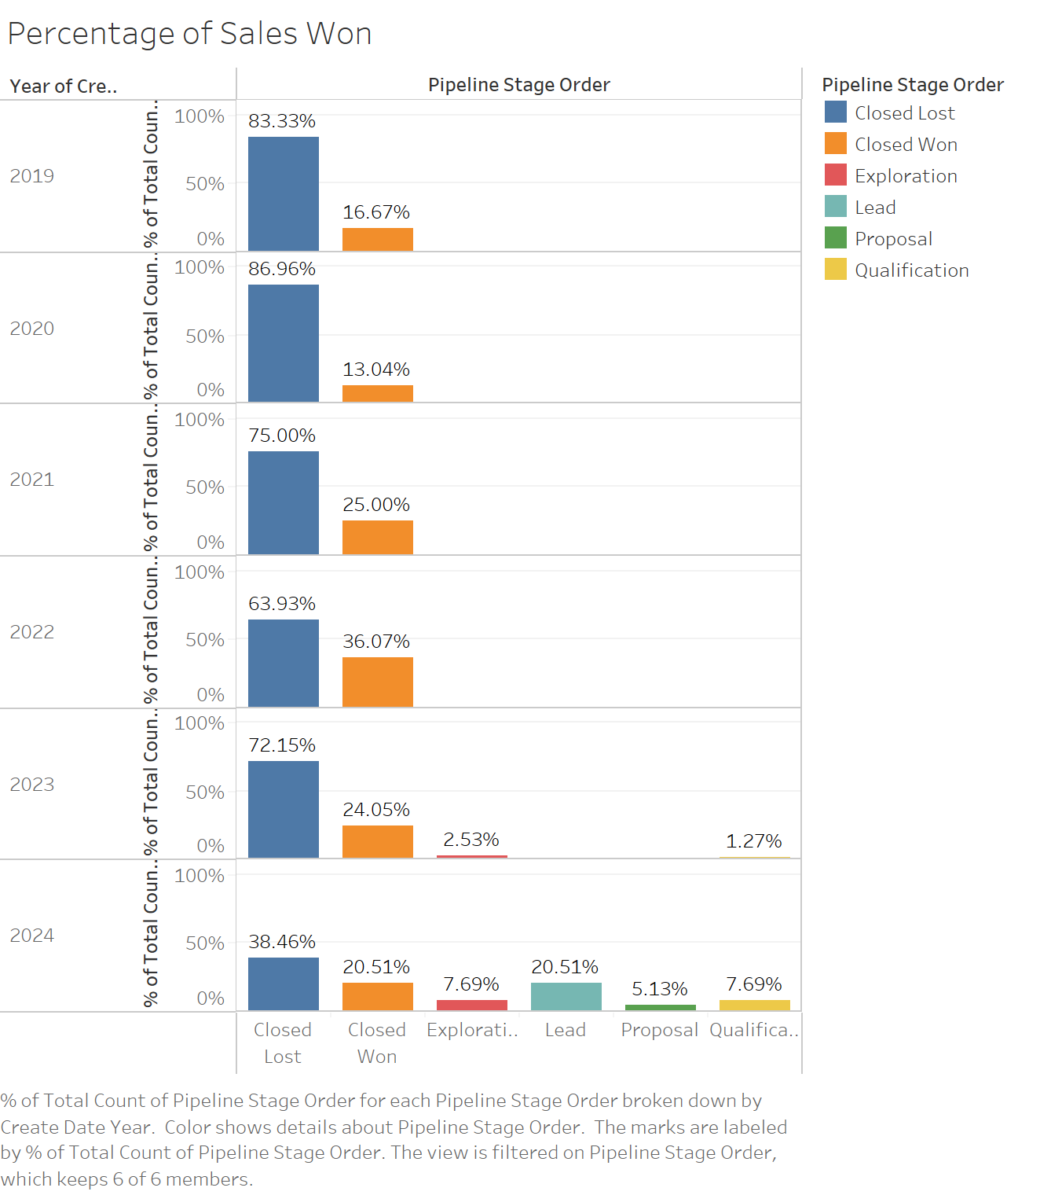
Sales Performance
Notes:
We can also see an increase in the total number of sales attempts as the company grew in size. Additionally, the higher rate of sales won indicates improved performance.

Slide 15
Conclusion and Insights
Sales
Hiring strategy
Relate sales wins to client value for the company
Implement sales strategy based on the data
Monitor Consultant Performance:
Analyze individual consultant profitability
Reflect insights on hiring strategies
Notes:
To conclude, it is crucial to monitor individual consultant performance to understand their profitability and refine our hiring strategies accordingly. Additionally, evaluating the value of sales won helps us relate sales performance to client worth, allowing us to prioritize high-value clients.
Strategize towards the company, what are the trends and patterns in DAta Edged Sales performance of size and industry

